Slide 1


Slide 2
C# Day 3 Lecture13: Exception Handling

Slide 3
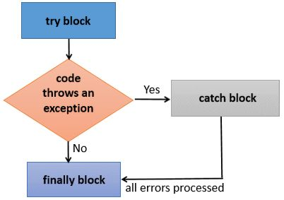
Exception Handling
try
catch
finally
throw

Slide 4
Exception Handling
System.IO.IOException
System.OutOfMemoryException
System.InvalidCastException
System.ArrayTypeMismatchException
System.DivideByZeroException
System.StackOverflowException

Slide 5
Exception Handling
int.Parse("abc");

Slide 6
Exception Handling
try
{
int.Parse("abc");
}
catch(Exception ex)
{
}

Slide 7
Exception Handling
try
{
int.Parse("abc");
}
catch(DivideByZeroException ex)
{
}
catch(Exception ex)
{
}

Slide 8
Exception Handling
try
{
StreamWriter w = new StreamWriter("File.txt",false);
w.WriteLine(“Hello,");
w.WriteLine("Abir");
w.Close();
StreamReader s = new StreamReader("File.txt");
Console.WriteLine(s.ReadToEnd());
s.Close();
Console.ReadKey();
}

Slide 9
Exception Handling
catch (FileNotFoundException ex)
{ Console.WriteLine(ex.FileName +" not found");
Console.ReadKey();
}
catch (Exception ex)
{
Console.WriteLine(ex.Message);
Console.ReadKey();
}

Slide 10
Exception Handling
try
{ StreamWriter w = new StreamWriter("File.txt",false); //if true it will append if false it will write
w.WriteLine(“Hello");
w.WriteLine("Abir");
w.Close();
StreamReader s = new StreamReader("File.txt");
Console.WriteLine(s.ReadToEnd());
s.Close();
Console.ReadKey();
}
catch (FileNotFoundException ex)
{ Console.WriteLine(ex.FileName +" not found");
Console.ReadKey();
}
catch (Exception ex)
{ Console.WriteLine(ex.Message);
Console.ReadKey();
}

Slide 11
This slide is provided as a course material in the workshop named “Workshop on C# Programming: Learn to Build”.
Organized by-
East West University Computer Programming Club (EWUCoPC)
Prepared by- Jannat Binta Alam
Campus Ambassador
Young Engineers Society (YES)
E-mail: jannat.cse.ewu@gmail.com

